Slide 1


Food Bacteria Classification
Saif Ur Rehman Khan
Intelligent Network and Cooperative Computing Research Group
05, July 2023

Slide 2
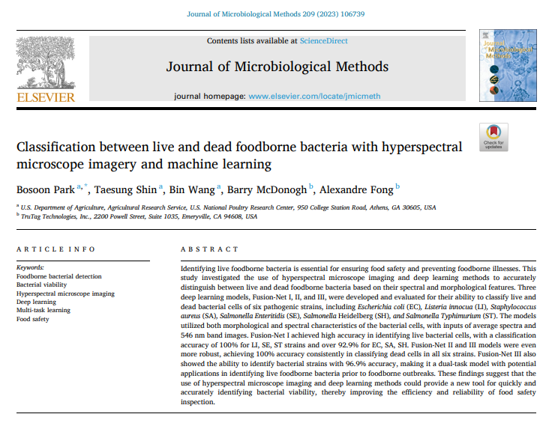

Slide 3
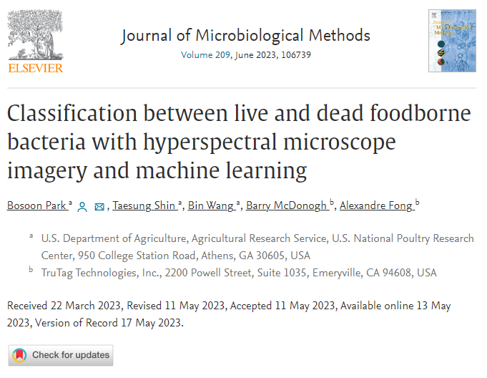
Classification between live and dead foodborne bacteria with hyperspectral microscope imagery and machine learning

Slide 4
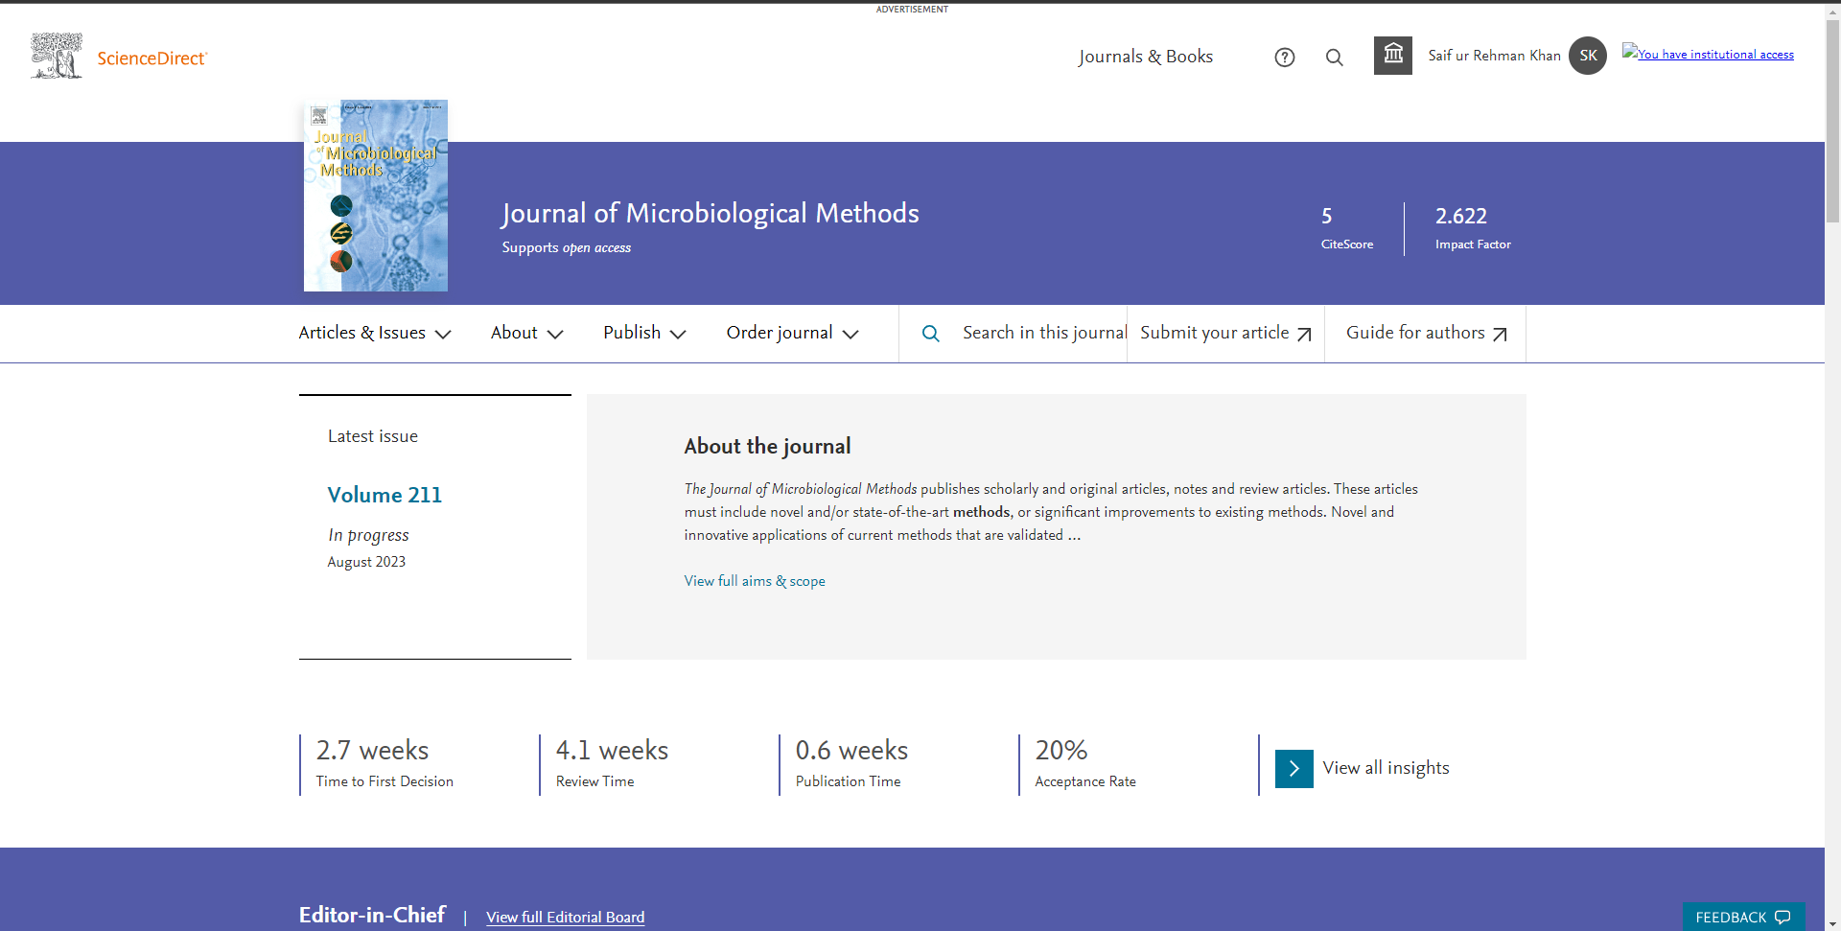

Slide 5

Background and Motivation
Introduction
Foodborne diseases cause a serious public health problem, with a widely accepted estimation of 9 million sicknesses, 56,000 hospitalizations, and 1300 deaths every year according to WHO.
The accurately characterizing the behavior of microorganisms in food is crucial for preventing and mitigating food safety issues.
Due to non-culturable challenges, it is essential to provide science-based data on characteristics of viable bacteria that support decision-making and enable early responses to such events.
Former Approach Problems
Most of culture-independent methods require certain incubation time to stain or label the live/dead bacteria, such as fluorescent labeling and isotope probing.
The major challenge to the early detection of pathogenic bacteria with HMI is the large size of datasets generated in the 3-dimensional hypercube, which requires a long time to extract and analyze redundant image data manually.
Contributions
In this research, hyperspectral microscopic images of major foodborne bacteria were acquired at single cell level, with spectral and morphological features of live and dead bacteria cells and a hybrid DL framework, Fusion-Net model, was developed to differentiate live and dead bacteria with high accuracy.
Notes:
Hyperspectral microscope imaging (HMI)

Slide 6
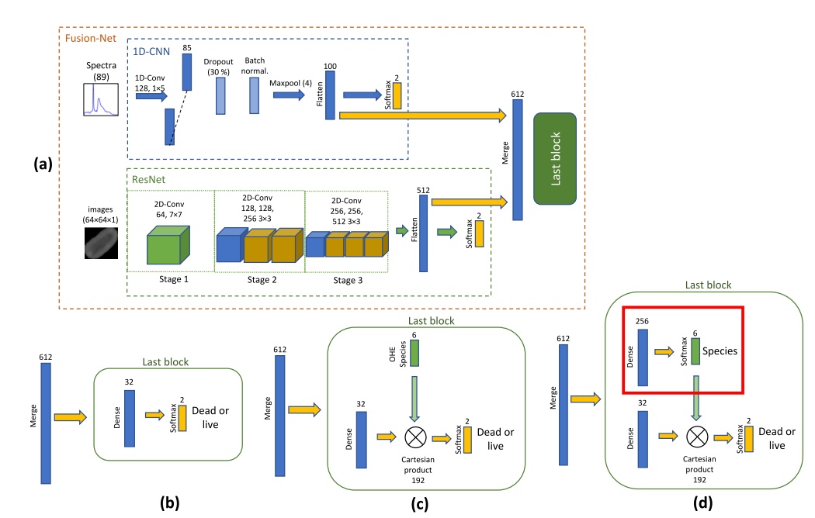
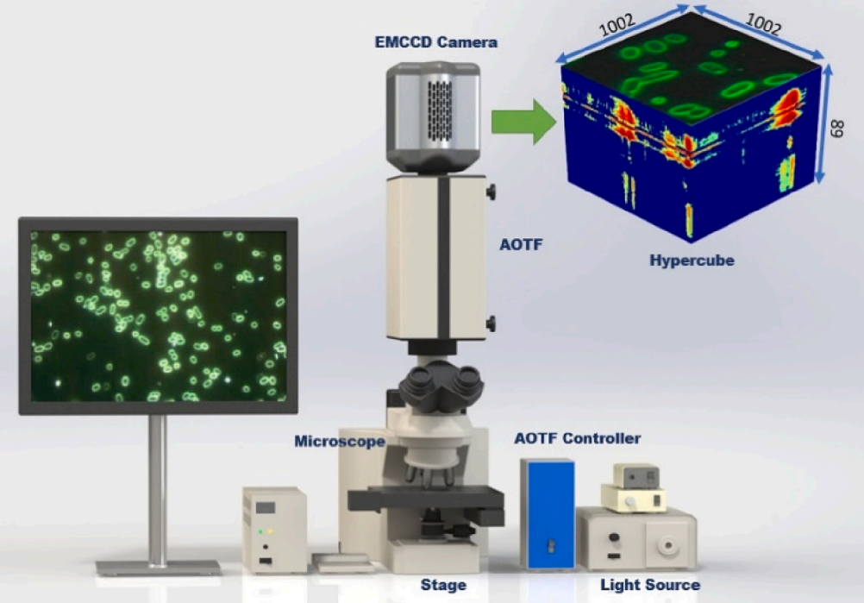
Three Fusion-Nets Architecture
Fig 1: Hyperspectral microscope imaging system with an AOTF spectrometer and EMCCD camera
Fig 2: Architectures of the three Fusion-Nets to detect viability of bacterial cells: (a) common architecture of the three networks, (b) the last block of Fusion-Net I without strain information, (c) the last block of Fusion-Net II with strain as an input, (d) the last block of Fusion-Net III with strain as another output.
Notes:
Acousto-optical tunable filter (AOTF)
electron multiplying charge coupled device (EMCCD)

Slide 7
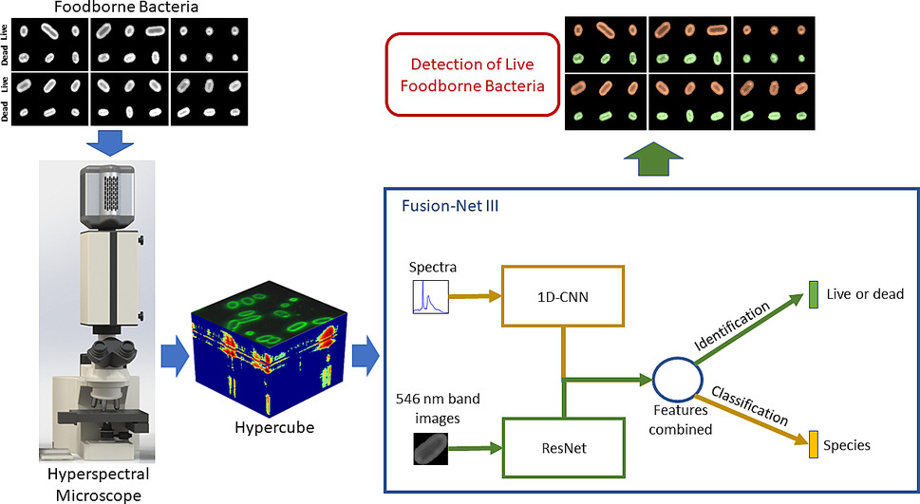
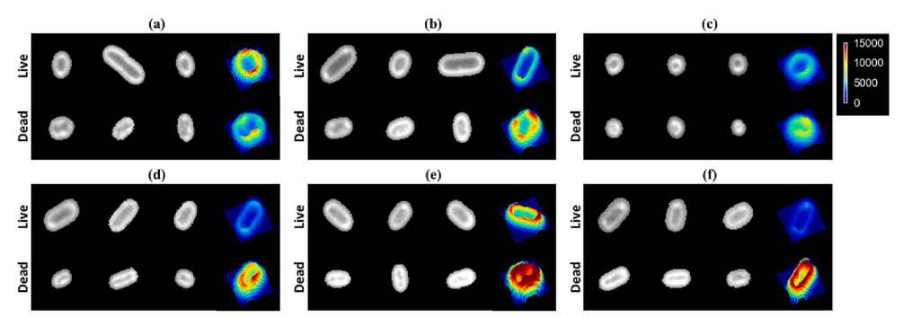
Three Fusion-Nets Architecture
E. coli
Listeria innocua
Staphylococcus aureus
Salmonella Enteritidis
Salmonella Heidelberg
Salmonella Typhimurium
Fig 3: Proposed Architectures with three Fusion-Nets to detect viability of bacterial cells
Fig 4: Comparison of six different bacterial strains between live and dead single cells
Notes:
They have used Basic ResNet model.
Dataset is highly imbalanced in nature.
Images size of each bacteria is 50*50.
There is no feature visualization and feature analysis.
More research about XAI needs to be done to fully understand and develop robust DL model for identification of bacterial cell viability.

Slide 8
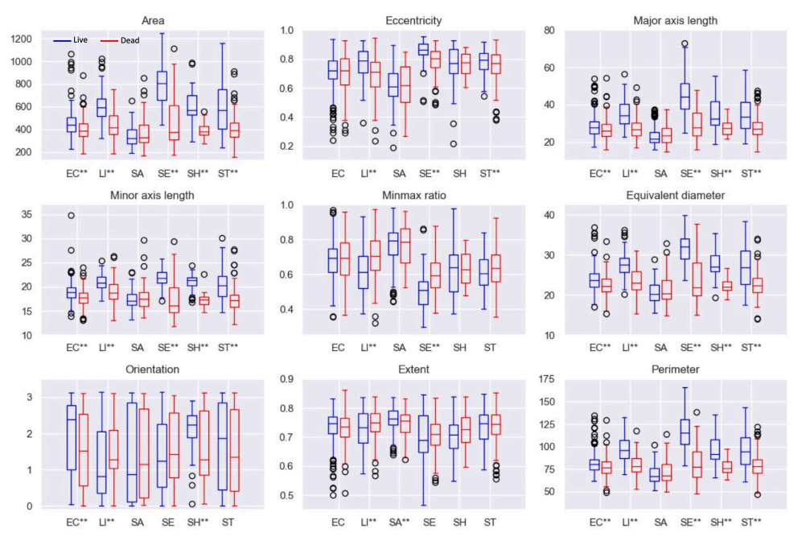
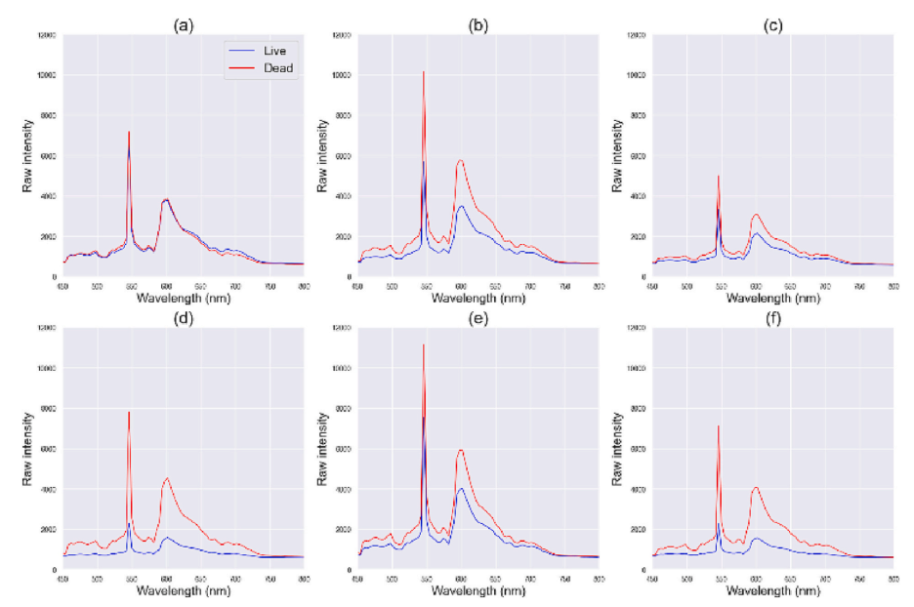
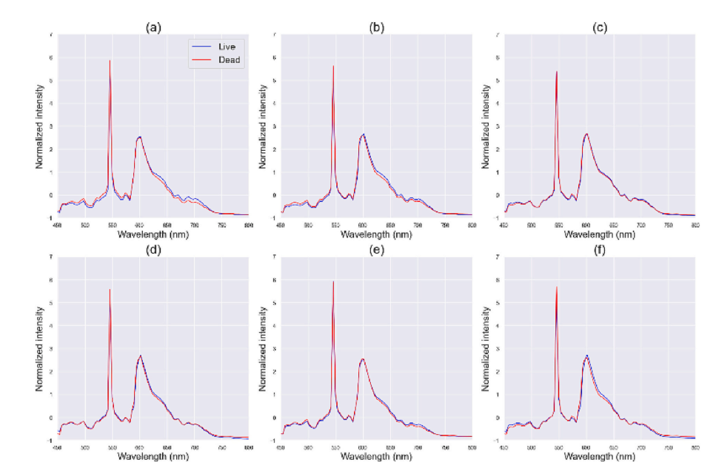
Results of the Three Fusion-Nets Architecture
Fig 6: Comparison of average raw spectra from different bacterial strains
Fig 5: Results of morphological analysis of live and dead bacteria
Fig 7: Comparison of average raw spectra from different bacterial strains
Notes:
Fig 5, Live (blue) and dead (red) cells of E. coli (EC, n = 407), Listeria innocua (LI, n = 172), Staphylococcus aureus (SA, n = 197), Salmonella Enteritidis (SE, n = 144), Salmonella Heidelberg (SH, n = 82), Salmonella Typhimurium (ST, n = 272). ** indicates a significant difference (p < 0.05) between live and dead bacterial cells of the given strain in the specific shape property. (For interpretation of the references to colour in this figure legend, the reader is referred to the web version of this article.)
Fig 6, Comparison of average raw spectra from different bacterial strains; (a) E. coli (n = 407), (b) Listeria innocua (n = 172), (c) Staphylococcus aureus (n = 197), (d) Salmonella Enteritidis (n = 144), (e) Salmonella Heidelberg (n = 82), (f) Salmonella Typhimurium (n = 272).
Fig 7, Comparison of average spectra processed with standard normal variate from different bacteria strains; (a) E. coli (n = 407), (b) Listeria innocua (n = 172), (c) Staphylococcus aureus (n = 197), (d) Salmonella Enteritidis (n = 144), (e) Salmonella Heidelberg (n = 82), (f) Salmonella Typhimurium (n = 272).

Slide 9
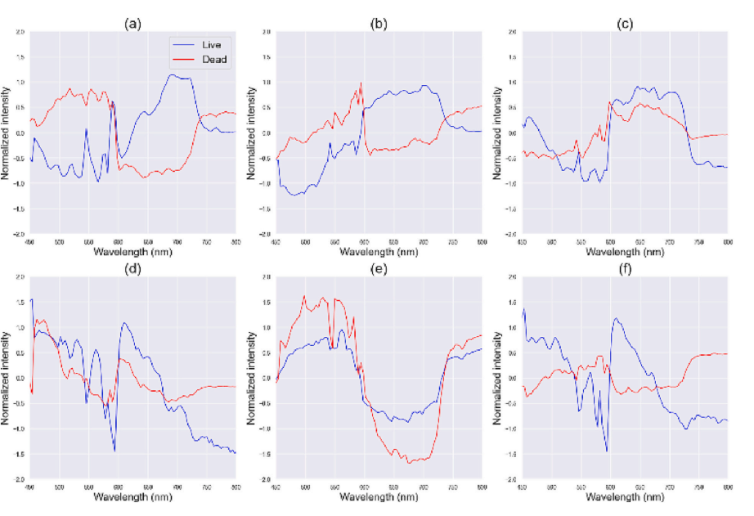
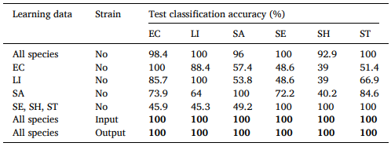
Results of the Three Fusion-Nets Architecture
Table 1: Test classification accuracies of Fusion-Nets with different learning datasets of specific species and inclusion of strain as an input or an output
Fig 8: Comparison of average spectra processed with Z-transformed standard normal variate from different bacteria species
Notes:
Table 1, Test classification accuracies of Fusion-Nets with different learning datasets of specific species and inclusion of strain as an input or an output; Strain column indicates models without strain information (No, Fusion-Net I), with one-hotencoded strain input (Input, Fusion-Net II), or with self-predicted strain output (Output, Fusion-Net III). Note: Species include E. coli (EC), Listeria innocua (LI), Staphylococcus aureus (SA), Salmonella Enteritidis (SE), Salmonella Heidelberg (SH), Salmonella Typhimurium (ST).
Fig 8, Comparison of average spectra processed with Z-transformed standard normal variate from different bacteria species: (a) E. coli (n = 407), (b) Listeria innocua (n = 172), (c) Staphylococcus aureus (n = 197), (d) Salmonella Enteritidis (n = 144), (e) Salmonella Heidelberg (n = 82), (f) Salmonella Typhimurium (n = 272).

Slide 10
Limitations
There are several limitations exist in the introduced framework.
They have used Basic ResNet model (high computation).
Dataset is highly imbalanced in nature.
Images size of each bacteria is 50*50 (too small).
There is no feature visualization and feature analysis.
More research about XAI needs to be done to fully understand and develop robust DL model for identification of bacterial cell viability.
Fig 9: Sample of Foodborne Bacteria Dataset

Slide 11
My Future Work
Image processing techniques (Histogram equalization, OTSU thresholding) will be employed to enhance the image quality and size.
Dataset is imbalanced, my focus is to develop a CNN architecture that will perform good on both balance and imbalance dataset.
Plan to proposed a novel lightweight CNN architecture that will the decrease the computation complexity and increase the model performance.
Model training will be performed on both CPU and GPU for complexity comparison.
Feature analysis (LIME, Grad-CAM and feature maps) will be performed on each bacterial strain.
Pre-trained base will be trained on same data to perform deep performance and computation comparison (FLOPS, Parameters, Model size, Run time) with our CNN.

Slide 12




Initial Result
1274 food bacterial images of six different classes
Fig 10: Base Dataset
Fig 11: Applied Image processing techniques (Histogram equalization, OTSU thresholding) that be employed to enhance the image quality and size.

Slide 13
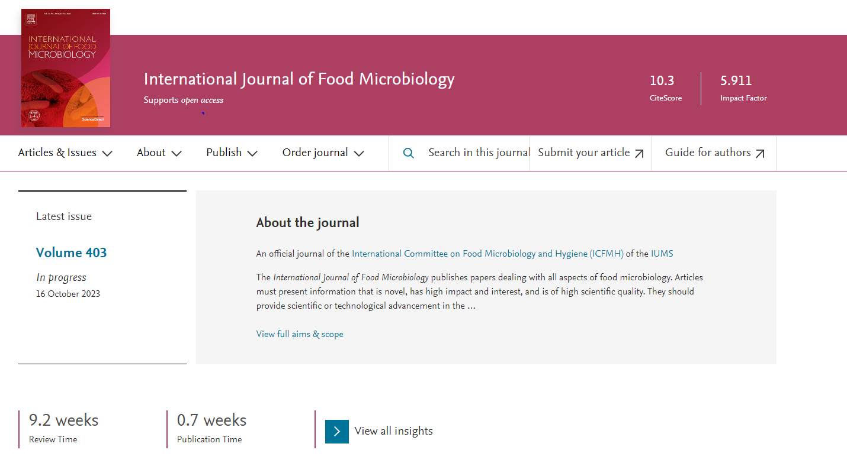
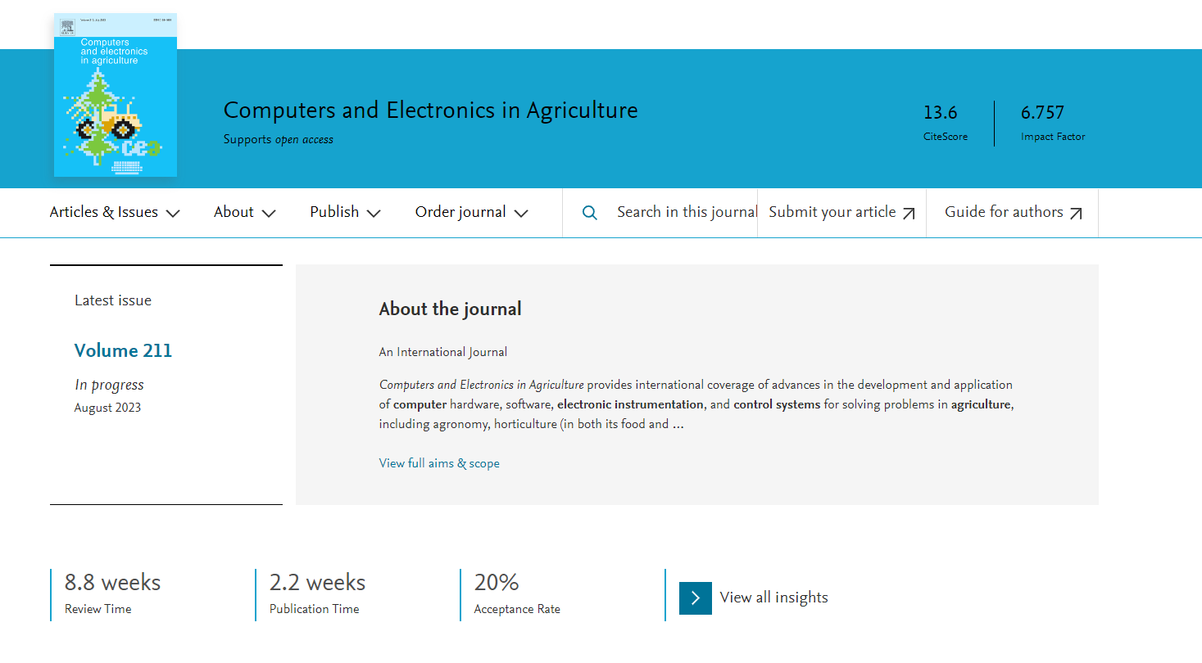
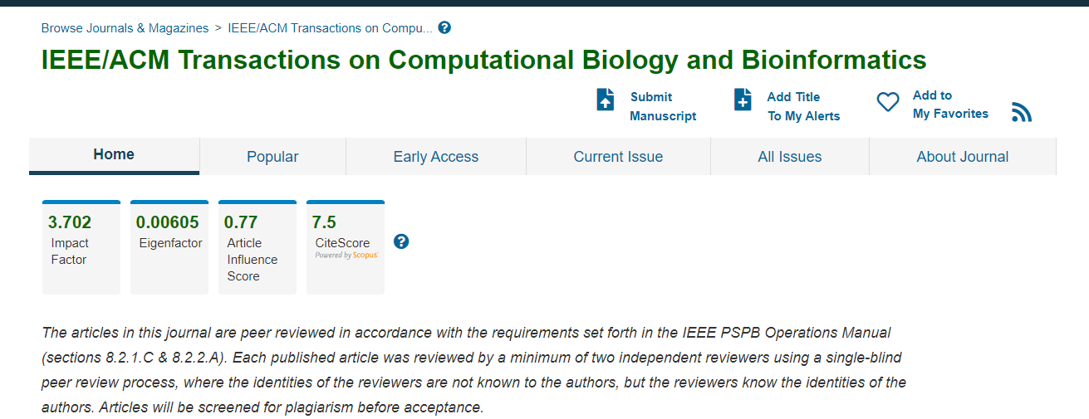
Targeted Journal

